Slide 1
PIP HW#5
22211236
Taehyeon Jeong

Slide 2
Contents
Introduction
Problem
Raw Image Data structure
Bayer interpolation methods
Boundary problem in parallel processing
Code of project
Result
Conclusions And Discussions

Slide 3
Introduction
8bit raw image to 10bit data
Serial source code for Bayer interpolation
Parallel code (OpenMP using for or section)
Compare the result
Compare the processing time

Slide 4
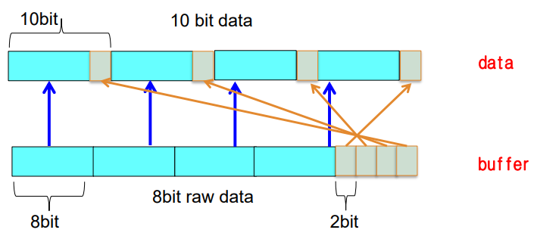
Raw Image Data Structure
Move 8 bits 2 bits within 10 bits through the left shift operator
Proceed with the fifth raw data 11(2) and the & bit operator to generate 10-bit data

Slide 5
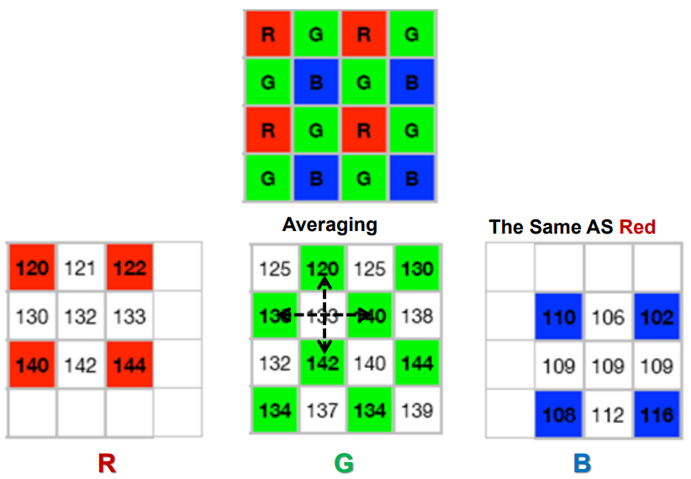
Bayer interpolation methods
Find the average value according to the surrounding pixel, as shown in the figure
Create an RGB 3-channel image from a 1-channel image with Bayer interpolation
Corner, Edge, Inside의 3부분으로 나눠 주변 픽셀 값을 이용해 interpolation

Slide 6
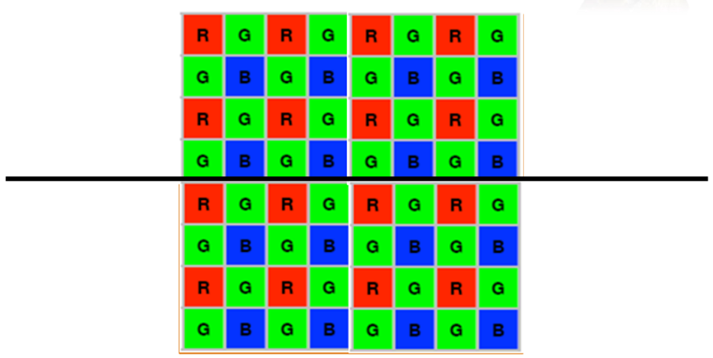
Boundary problem in parallel processing
In parallel image processing, each thread boundary part should be handled well
Otherwise, empty pixels may occur in the boundary portion of the resulting image or become qualitatively odd
계산의 효율성을 위해 정사각형이 아닌 아래와 같이 직사각형의 형태로 병렬화를 진행한다
Thread 0
Thread 1
Thread 2
Thread 3

Slide 7
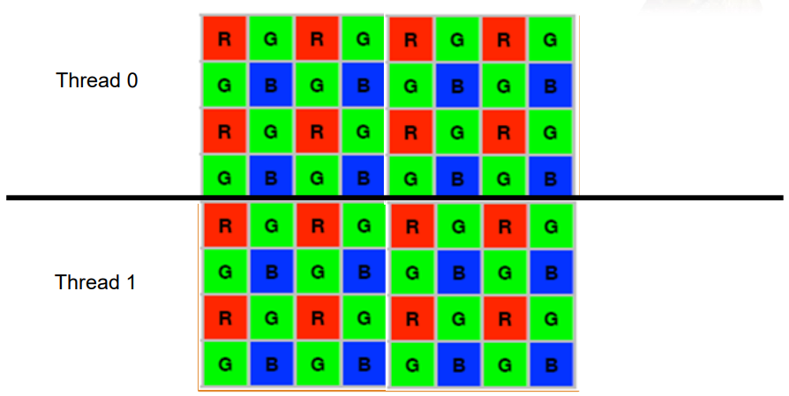
Boundary problem in parallel processing
Serial 코드와 동일한 결과를 출력하기 위하여 Image를 First, Inner, Last 세 Section으로 나눠 각각 Interpolation 진행
병렬처리를 진행하기 전 First Row, Last Row의 interpolation을 계산
나머지 Inner Row를 원하는 thread만큼 나눠 병렬처리를 진행
First Section Interpolation
Inner Section Interpolation
Last Section Interpolation

Slide 8
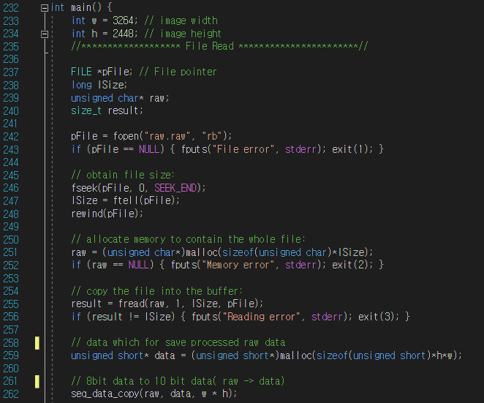
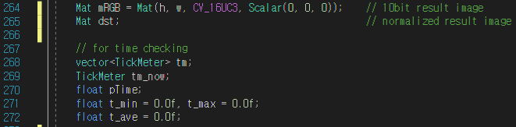
Main #1
3개의 task로 이루어져 실행된다
Task 1 : 8bit raw data를 10bit data로 변경
Task 2 : Serial / Parallel Interpolation 및 iteration 내 평균 계산 시간 측정
Task 3 : Image 확인을 위한 Normalizing
Task 1 : 8bit raw data to 10bit data
Task 2 : 평균 계산 측정 변수 설정

Slide 9
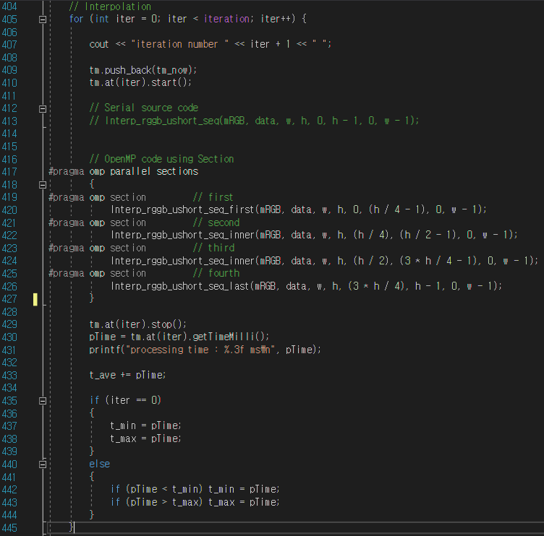
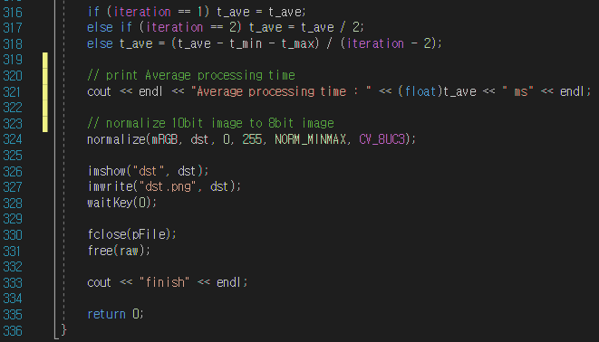
Main #2
Task 2 : Serial / Parallel Interpolation
Task 3 : Normalize and show image

Slide 10
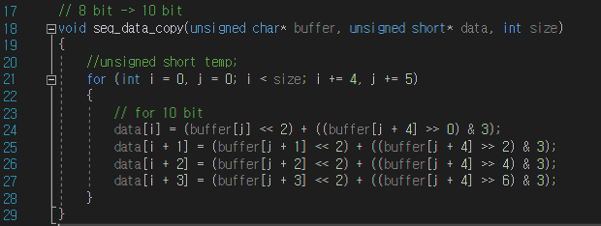
Sequence 8bit copy to 10bit #1
기존 8bit raw data 5개를 통해 10bit data 4개를 생성
Left Shift와 &연산자를 통해 기존 data를 정제
자세한 내용은 Slide 4에 첨부
Sequence data copy to 10bit data

Slide 11
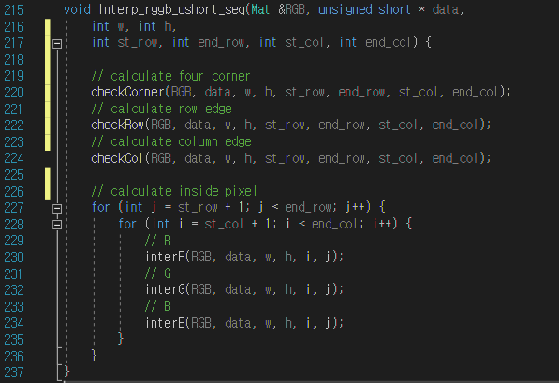
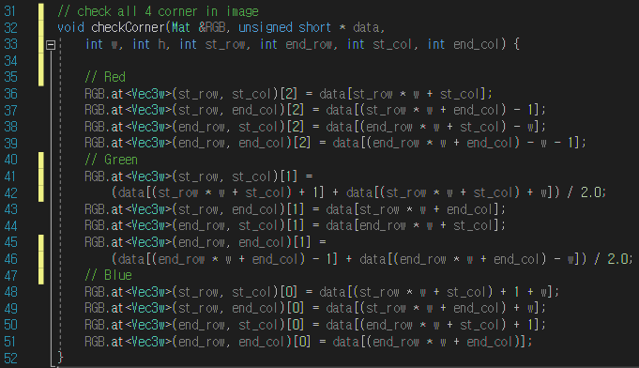
Serial Bayer Interpolation #1
Bayer Interpolation을 Serial로 작업한다면 별도의 Section별 계산이 불필요하다
추후 병렬 처리의 용이성을 Corner, Edge, Inside을 따로 계산하여 for문 내 if문을 줄인다
Task 1 : 한 이미지 내 4개의 Corner를 체크
Task 2 : 네 개의 Edge의 Interpolation을 진행
Task 3 : Edge와 Corner를 제외한 나머지 부분을 계산
Task 1
이미지의 네 꼭지점 Pixel 계산
Bayer interpolation code (Serial)
Task 1 : Calculate 4 corner in image

Slide 12
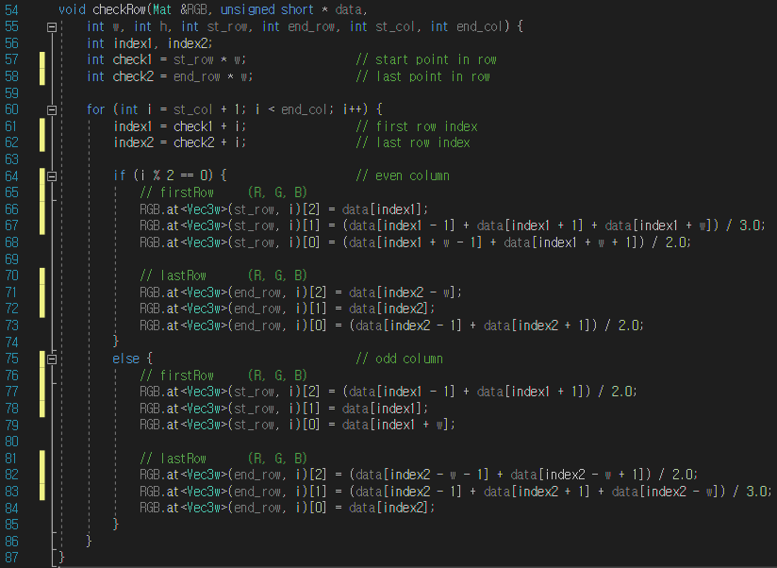
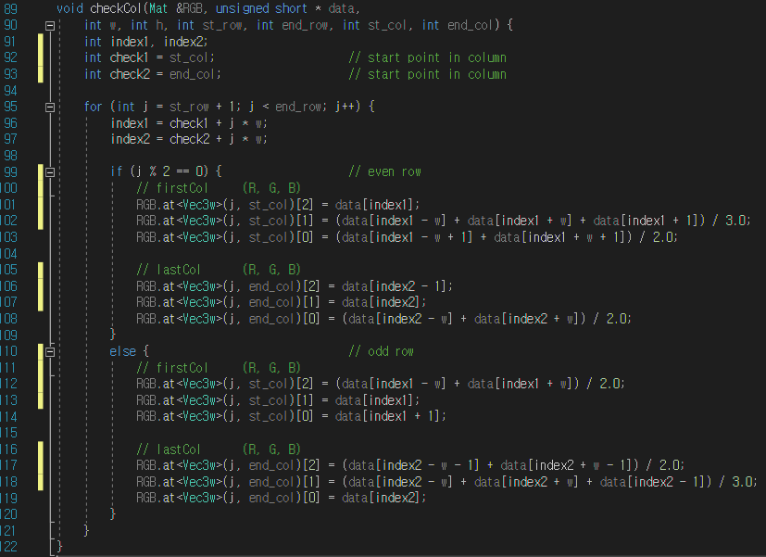
Serial Bayer Interpolation #2
Task 2
4개의 Corner를 제외한 나머지 Edge 부분을 RGB로 나눠 계산한다
Task 2 : Calculate row edge
Task 2 : Calcuate column edge

Slide 13
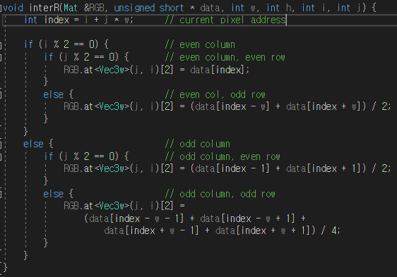
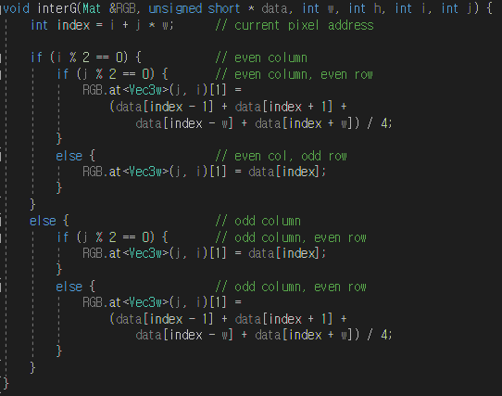
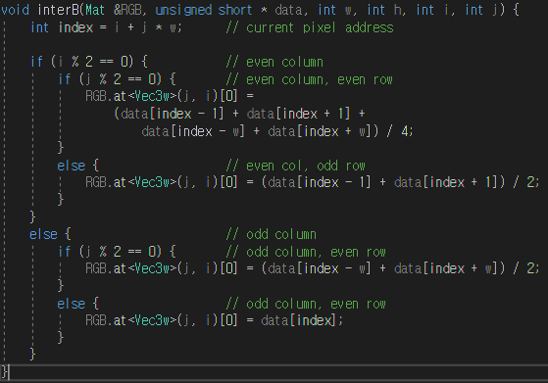
Serial Bayer Interpolation #3
Task 3
Corner와 Edge를 뺀 나머지 부분의 Interpolation을 진행한다
If문을 통해 행과 열이 (even, even), (even, odd), (odd, even), (odd, odd)중 어디에 속하는지 파악한 후 각 RGB에 따라 알맞은 계산을 진행한다
Calculate red pixel (not edge)
Calculate green pixel (not edge)
Calculate blue pixel (not edge)

Slide 14
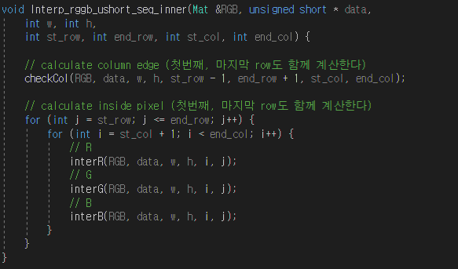
Parallel Bayer Interpolation #1
Bayer Interpolation 대상 이미지의 First Row, Last Row의 계산을 병렬처리 전 진행한다 (이에 따른 main 함수 변환 in next slide)
Corner와 Row의 계산이 필요 없는 Interp_rggb_ushort_inner 함수를 새로 정의한다
해당 함수를 원하는 thread만큼 나눠 병렬처리를 진행한다
First Section Interpolation
Inner Section Interpolation
Parallel Bayer interpolation code (Inner Section)
Last Section Interpolation

Slide 15
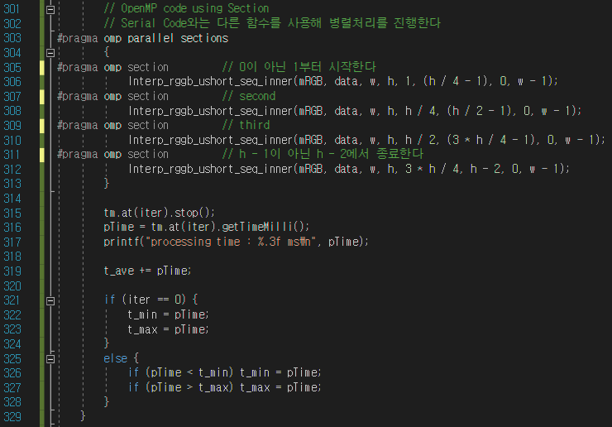
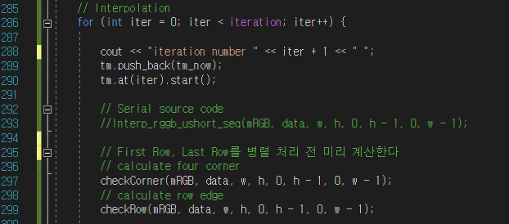
Parallel Bayer Interpolation #2
Bayer Interpolation 대상 이미지의 First Row, Last Row의 계산을 병렬처리 전 진행한다
Coner와 Row의 계산이 필요 없는 Interp_rggb_ushort_inner 함수를 새로 정의한다
해당 함수를 원하는 thread만큼 나눠 병렬처리를 진행한다
Parallel Bayer interpolation code (main function)

Slide 16
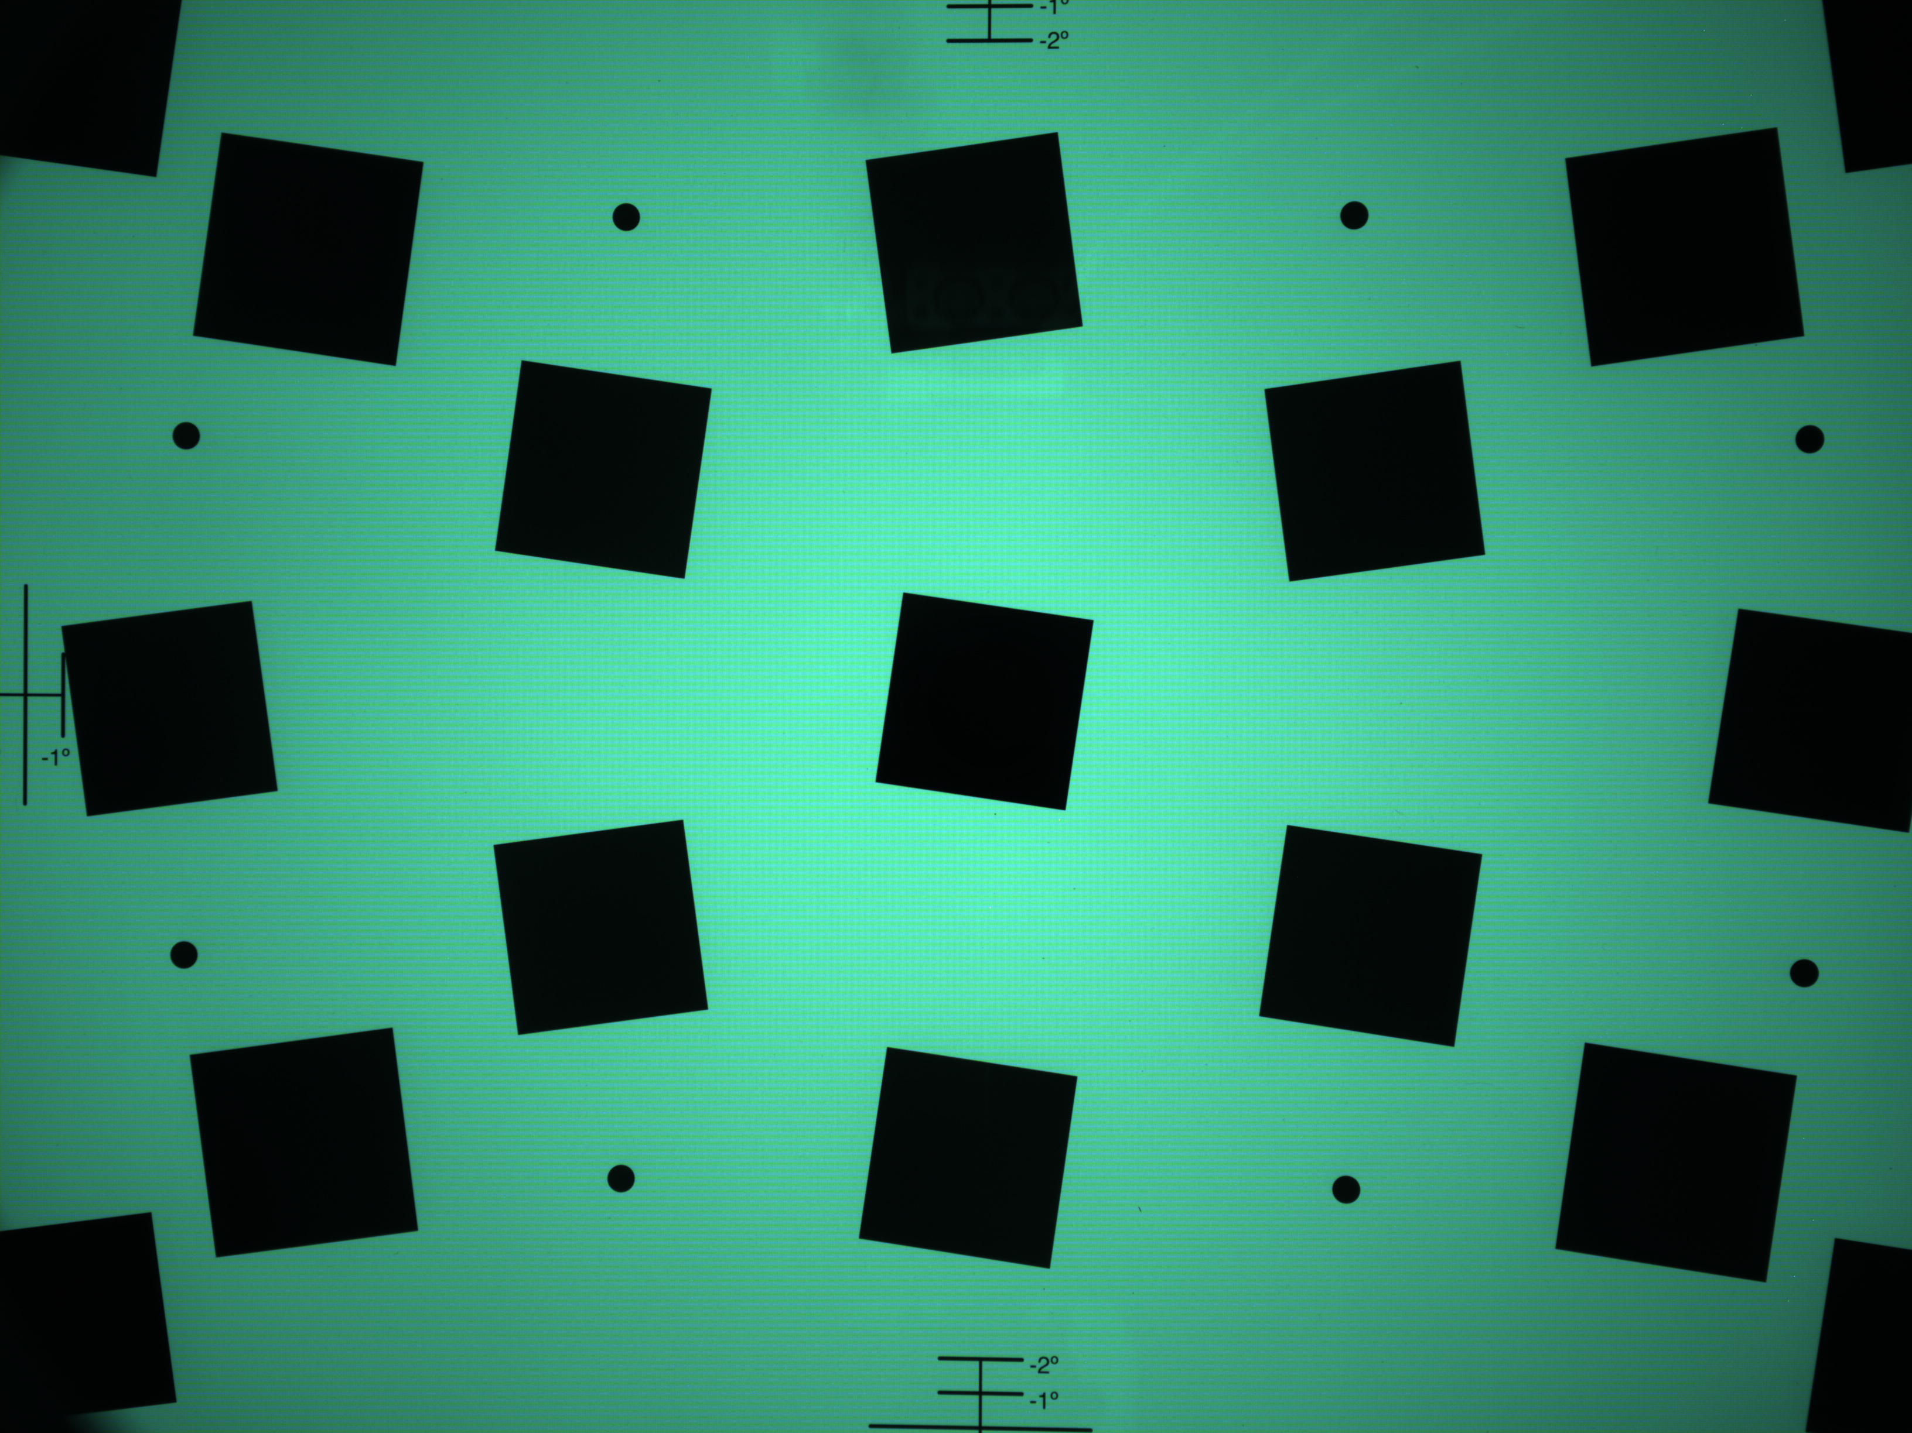

Result (image)
Both results output identical results qualitatively
Result of Serial code
Result of OpenMP code

Slide 17
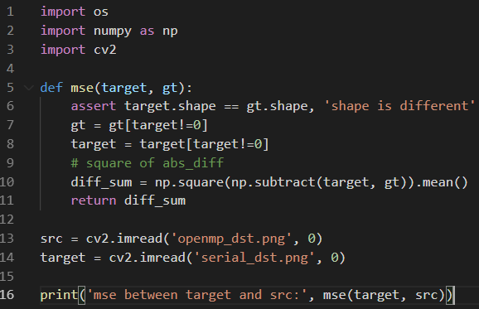
Result (evaluation)
Use MSE evaluation to make simple image comparisons
Quantitatively, the two images are identified to be identical
First, Inner, Last Section으로 나누는 Improving을 통해 MSE 결과 모두 동일한 이미지 출력
Result of Serial code
Result of OpenMP code

Slide 18
Result (Processing time)
With OpenMP, performance imporves as the number of threads increases.
Iteration | Size | # of Thread | Serial (msec) | OpenMP(msec)
10 | 3264 x 2448 | 1 | 27.84 | 35.64
 |  | 2 | 28.79 | 21.91
 |  | 4 | 28.08 | 13.91

Slide 19
Conclusions and discussions
As with the previous OpenMP task, the performance of interpolation improved as parallel threads increased. In particular, 4 threads showed twice the performance improvement compared to serial code.
Through this task, parallel image processing, unlike simple serial processing, requires additional work on edges or corners. It had to calculate by thread block by utilizing only pixels in the thread.
Although there is also a possibility of performance downgrade due to boundary partial computation, MSE evaluation confirms that there is very little quantitative difference.
I also learned how to extract raw data in bitwise tasks. Furthermore, the corresponding tasks are expected to be computed in parallel via OpenMP to improve performance.

